Slide 1

Patchwork
An Intuitive Package for Multi-Panel GGPLOts
(And other tips for publication ready plots)

Slide 2
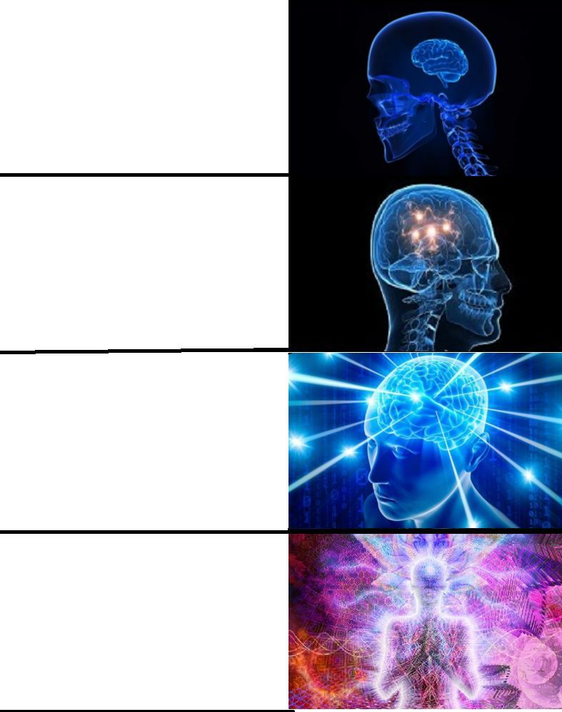
Constructing Multi-panel GGplots
Most multi-panel ggplot packages are NOT intuitive
Things are customizable but it you may spend hours finding the right function/command to do what you want
Patchwork is both intuitive and highly customizable!
“Nature doesn’t accept plots made in Kid Pix?”
Making individual ggplots and then begging your friend that has a pirated version of Adobe Illustrator to combine them
“There are packages that combine multiple ggplots?”
Patchwork!

Slide 3
Patchwork Background
Developer: Thomas Lin Pedersen – tidyverse dev and coding wizard
Website: https://patchwork.data-imaginist.com/
What you need to get started:
install.packages(“devtools”)
devtools::install_github(“thomasp85/patchwork”)

Slide 4
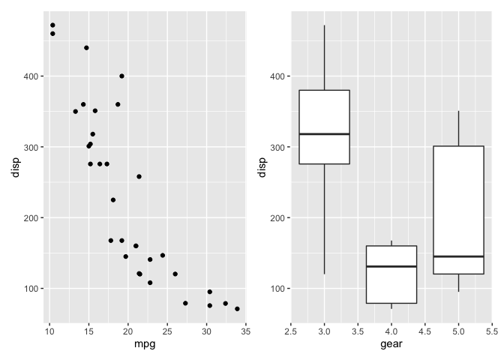
Basic Concept
Make some ggplots
library(ggplot2)
library(patchwork)
p1 <- ggplot(mtcars) + geom_point(aes(mpg, disp))
p2 <- ggplot(mtcars) + geom_boxplot(aes(gear, disp, group = gear))
p1 + p2
comb_plot <- p1 + p2

Slide 5
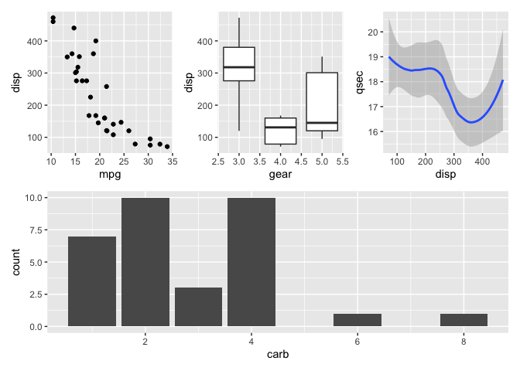
A bit more Complex…
p3 <- ggplot(mtcars) + geom_smooth(aes(disp, qsec))
p4 <- ggplot(mtcars) + geom_bar(aes(carb))
(p1 | p2 | p3) /
p4
+ automatically adds plots together
| combines plots horizontally
/ combines plots vertically
() isolates formatting within parentheses

Slide 6
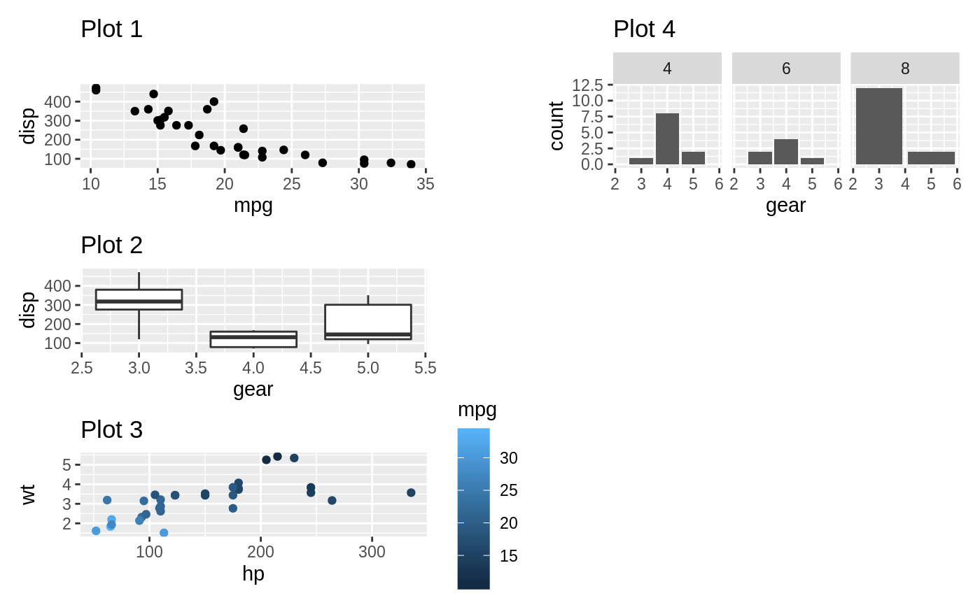
Arranging Plots, Annotating Plots, Controlling Guides
Custom arrangements
p1 + p2 + p3 + p4 + plot_layout(nrow = 3, byrow = FALSE)

Slide 7
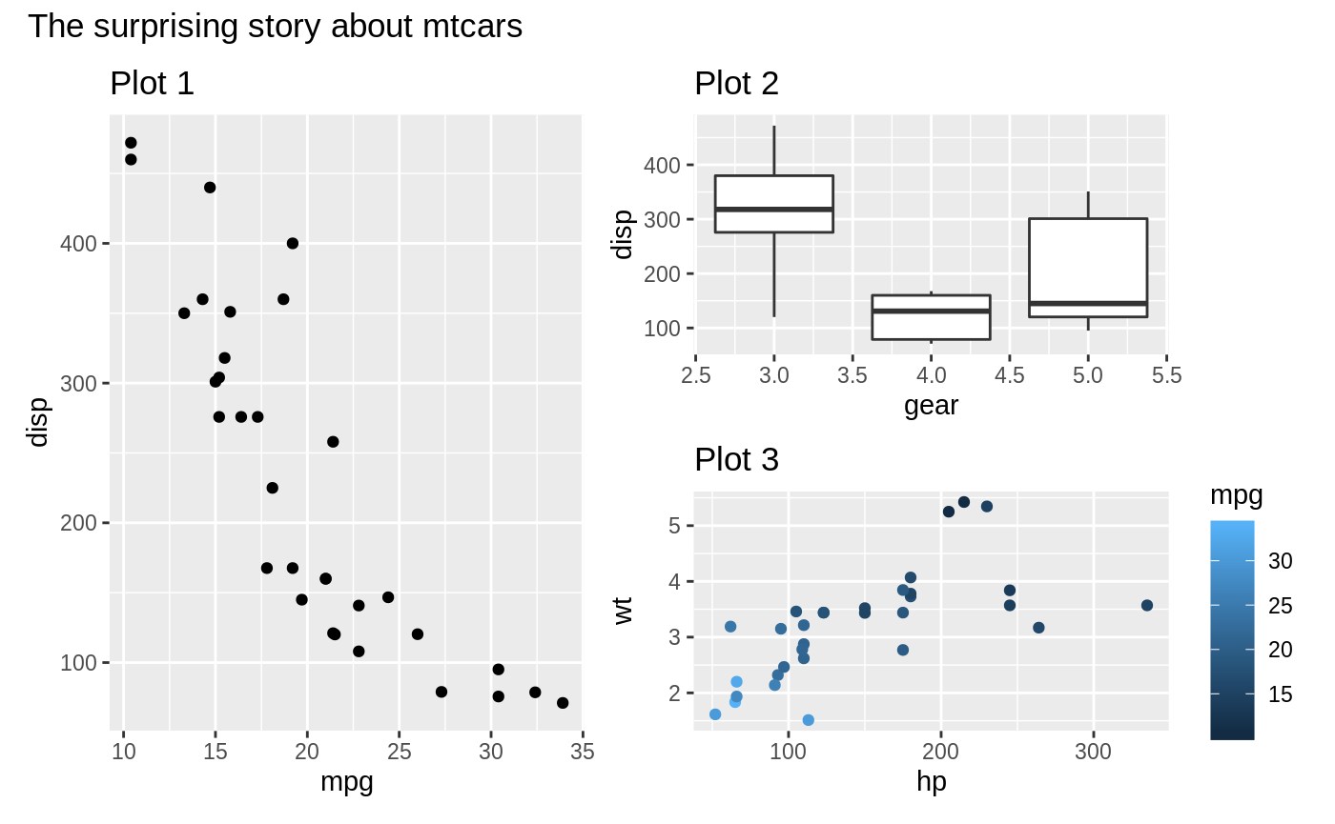
Arranging Plots, Annotating Plots, Controlling Guides
Custom arrangements
Titles and plot tags
p1 + p2 + p3 + p4 + plot_layout(nrow = 3, byrow = FALSE)
(p1 | (p2 / p3)) +
plot_annotation(title = 'The surprising story about mtcars')

Slide 8
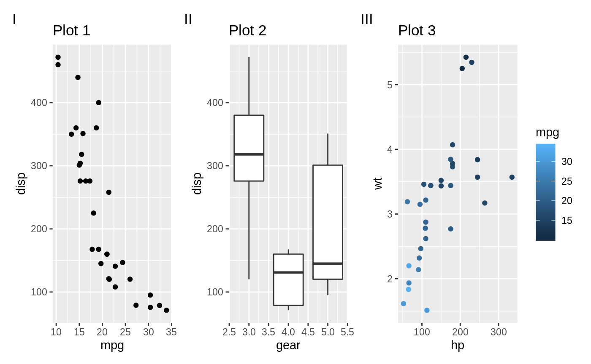
Arranging Plots, Annotating Plots, Controlling Guides
Custom arrangements
Titles and plot tags
p1 + p2 + p3 + p4 + plot_layout(nrow = 3, byrow = FALSE)
(p1 | (p2 / p3)) +
plot_annotation(title = 'The surprising story about mtcars')
p1 + p2 + p3 +
plot_annotation(tag_levels = 'I')

Slide 9
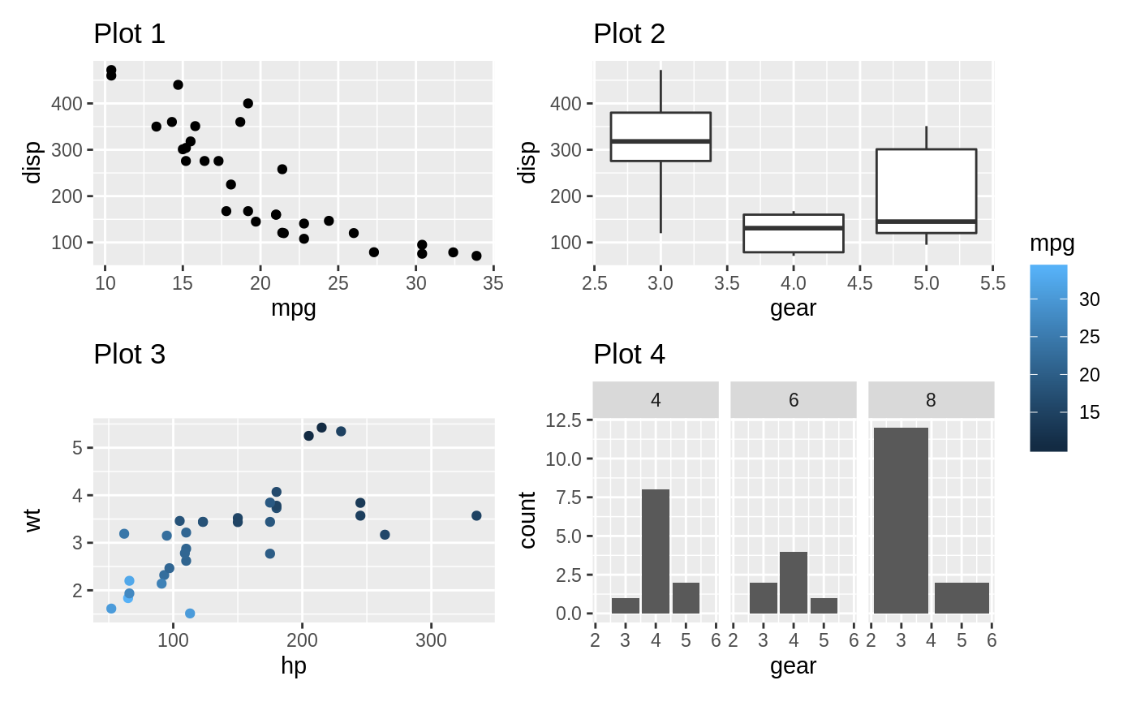
Arranging Plots, Annotating Plots, Controlling Guides
Custom arrangements
Titles and plot tags
Controlling guides
p1 + p2 + p3 + p4 + plot_layout(nrow = 3, byrow = FALSE)
(p1 | (p2 / p3)) +
plot_annotation(title = 'The surprising story about mtcars')
p1 + p2 + p3 +
plot_annotation(tag_levels = 'I')
p1 + p2 + p3 + p4 +
plot_layout(guides = 'collect')

Slide 10
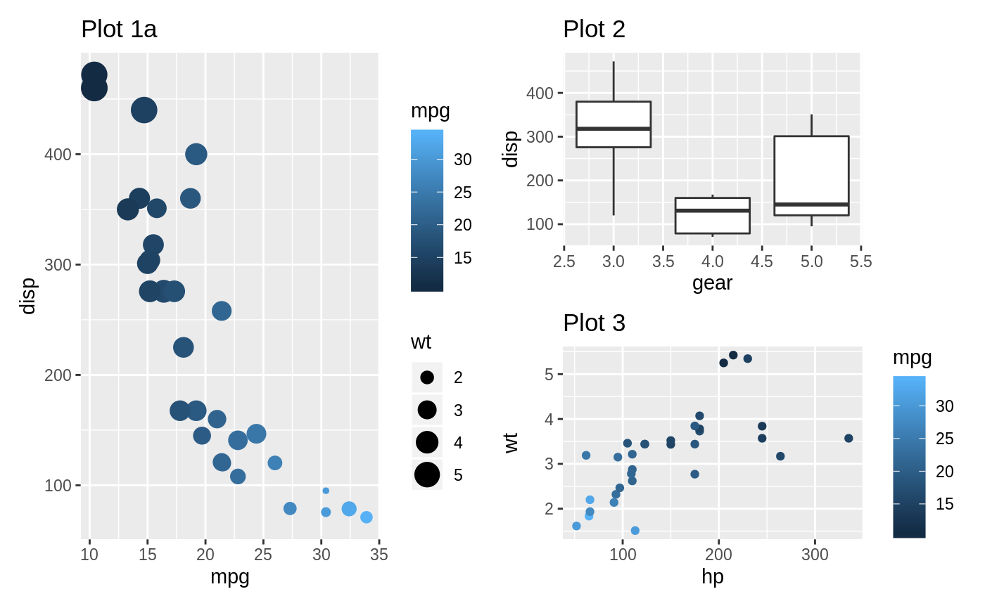
Arranging Plots, Annotating Plots, Controlling Guides
Controlling guides
p1a <- ggplot(mtcars) +
geom_point(aes(mpg, disp, colour = mpg, size = wt)) +
ggtitle('Plot 1a')
p1a | (p2 / p3)

Slide 11
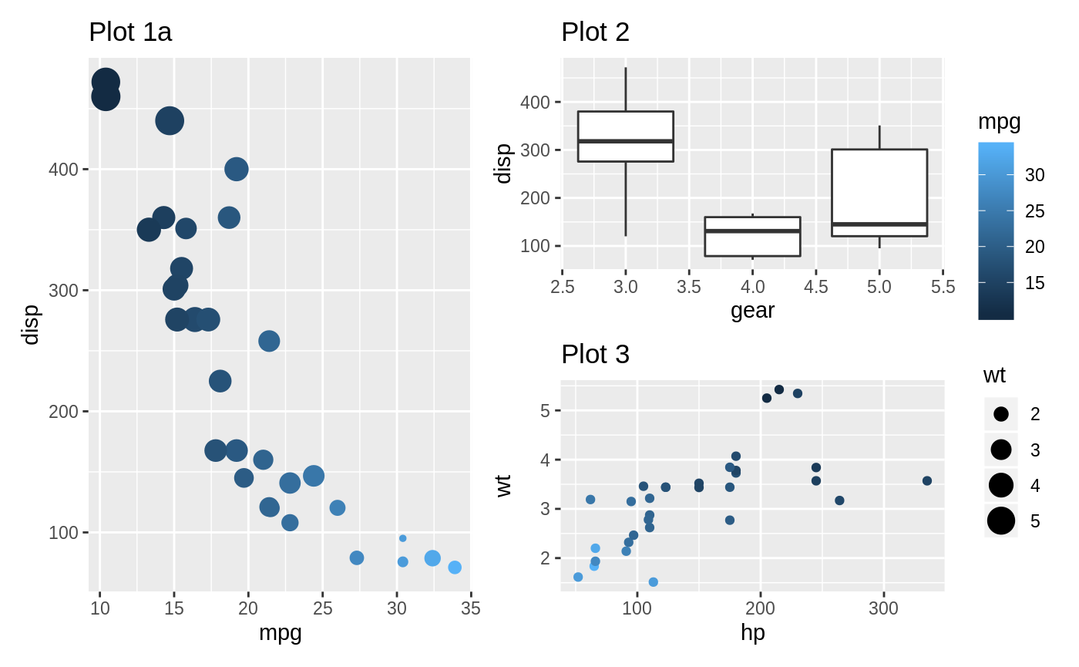
Arranging Plots, Annotating Plots, Controlling Guides
Controlling guides
p1a <- ggplot(mtcars) +
geom_point(aes(mpg, disp, colour = mpg, size = wt)) +
ggtitle('Plot 1a')
p1a | (p2 / p3)
(p1a | (p2 / p3)) + plot_layout(guides = 'collect')

Slide 12
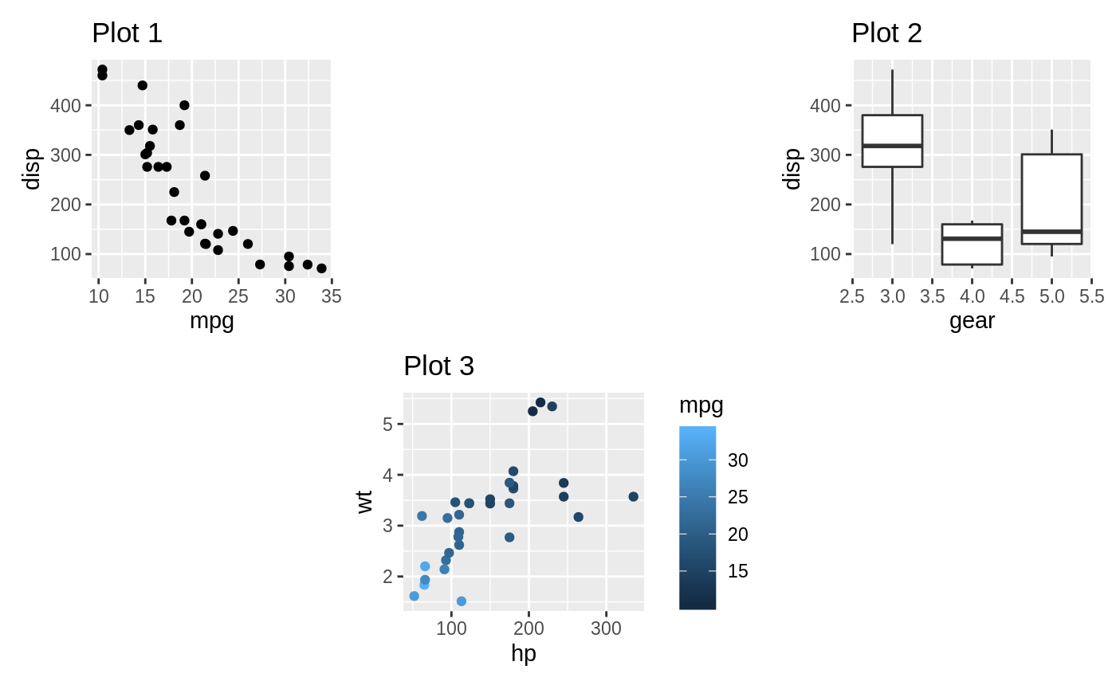
Advanced Plot Spacing
Adding blank areas
p1 + plot_spacer() + p2 + plot_spacer() + p3 + plot_spacer()

Slide 13
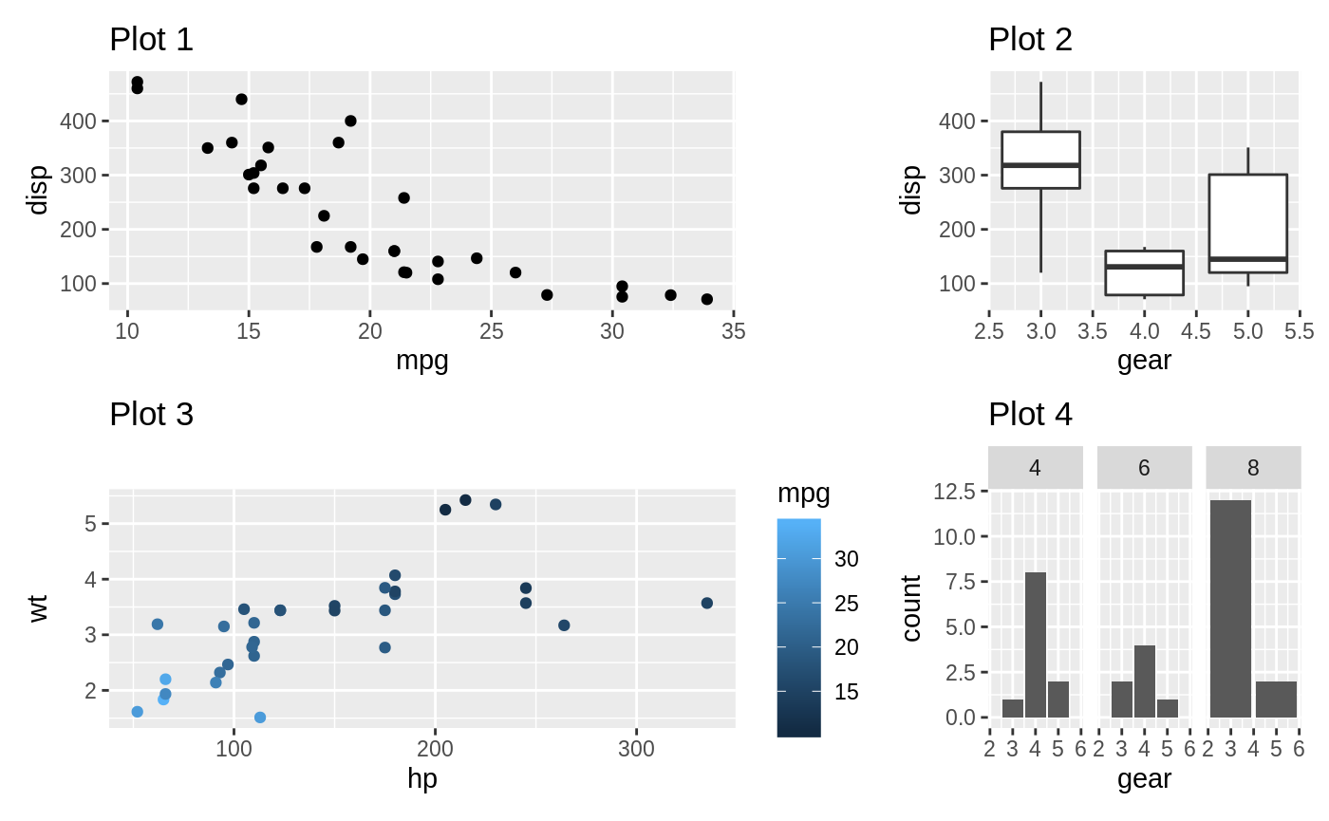
Advanced Plot Spacing
Adding blank areas
Varying the width or height of plots
p1 + plot_spacer() + p2 + plot_spacer() + p3 + plot_spacer()
p1 + p2 + p3 + p4 +
plot_layout(widths = c(2, 1))

Slide 14
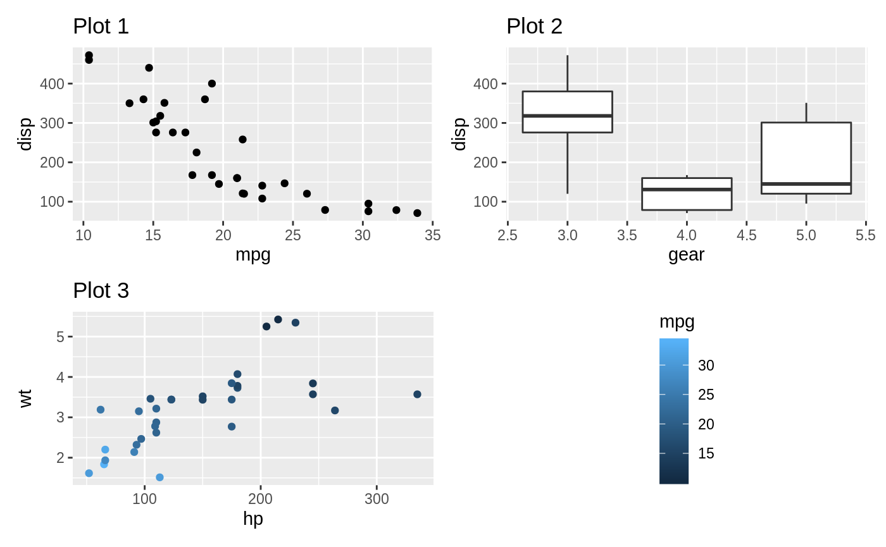
Advanced Plot Spacing
Adding blank areas
Varying the width or height of plots
Placing guides in blank areas
p1 + plot_spacer() + p2 + plot_spacer() + p3 + plot_spacer()
p1 + p2 + p3 + p4 +
plot_layout(widths = c(2, 1))
p1 + p2 + p3 + guide_area() +
plot_layout(guides = 'collect')

Slide 15
Need more?
Go to: https://patchwork.data-imaginist.com/articles/ to find all vignettes on patchwork!

Slide 16
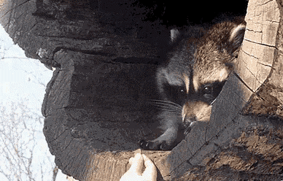
Tips and Tricks for Publication Ready Plots

Slide 17
The do’s and DON’ts of Plotting
DON’T set the individual font size for each plot
stations <- ggplot() +
geom_polygon(data = map, aes(x=long, y = lat, group = group), fill = "grey", color = "black") +
coord_fixed(xlim = c(-127, -116),ylim= c(28,37), 1.3) +
xlab("Longitude") + ylab("Latitude") +
geom_point(data = som_maps, aes (x = long, y = lat, fill = n_samps),
color = "black", size = 6, stroke = 0.1, shape = 21) +
scale_fill_gradient(name = "# of Samples", low = "white", high = "red") +
theme(panel.background = element_blank(),
panel.border = element_rect(fill = NA,colour = "black", linetype = "solid"),
plot.title = element_text(size = 11), axis.line = element_blank(),
legend.justification=c(1,1),
legend.position=c(0.97, 0.97),
legend.background = element_rect(fill = "white", color = "black"),
axis.text = element_text(size = 11),
legend.text = element_text(size = 11),
axis.title = element_text(size = 12),
legend.title = element_text(size = 11)) +
ggtitle("Samples per Station")

Slide 18
The do’s and DON’ts of Plotting
DON’T set the individual font size for each plot
DO make global variables for font size, point size, ect.
stations <- ggplot() +
geom_polygon(data = map, aes(x=long, y = lat, group = group), fill = "grey", color = "black") +
coord_fixed(xlim = c(-127, -116),ylim= c(28,37), 1.3) +
xlab("Longitude") + ylab("Latitude") +
geom_point(data = som_maps, aes (x = long, y = lat, fill = n_samps),
color = "black", size = 6, stroke = 0.1, shape = 21) +
scale_fill_gradient(name = "# of Samples", low = "white", high = "red") +
theme(panel.background = element_blank(),
panel.border = element_rect(fill = NA,colour = "black", linetype = "solid"),
plot.title = element_text(size = 11), axis.line = element_blank(),
legend.justification=c(1,1),
legend.position=c(0.97, 0.97),
legend.background = element_rect(fill = "white", color = "black"),
axis.text = element_text(size = 11),
legend.text = element_text(size = 11),
axis.title = element_text(size = 12),
legend.title = element_text(size = 11)) +
ggtitle("Samples per Station")
stations <- ggplot() +
geom_polygon(data = map, aes(x=long, y = lat, group = group), fill = "grey", color = "black") +
coord_fixed(xlim = c(-127, -116),ylim= c(28,37), 1.3) +
xlab("Longitude") + ylab("Latitude") +
geom_point(data = som_maps, aes (x = long, y = lat, fill = n_samps),
color = "black", size = p_size, stroke = 0.1, shape = 21) +
scale_fill_gradient(name = "# of Samples", low = "white", high = "red") +
theme(panel.background = element_blank(),
panel.border = element_rect(fill = NA,colour = "black", linetype = "solid"),
plot.title = element_text(size = t_size), axis.line = element_blank(),
legend.justification=c(1,1),
legend.position=c(0.97, 0.97),
legend.background = element_rect(fill = "white", color = "black"),
axis.text = element_text(size = t_size),
legend.text = element_text(size = t_size),
axis.title = element_text(size = t_size),
legend.title = element_text(size = t_size)) +
ggtitle("Samples per Station")

Slide 19
The do’s and DON’ts of Plotting
DON’T set the individual font size for each plot
DON’T make plots super specific if you can help it
DO make global variables for font size, point size, ect.
reg_plot_cluster_1 <- ggplot(som_plots, aes(x = NO3_uM, y = freq, color = cluster_1)) +
geom_point() +
stat_smooth(method="glm", method.args = list(family = "binomial")) +
theme(legend.title = element_blank(),
panel.background = element_blank(),
panel.border = element_rect(fill = NA, color = "black"),
plot.title = element_text(hjust = 0.5)) +
xlab() + ylab("Frequency") +
scale_color_manual(values = c("red", "blue")) + ggtitle(“NO3 ~ Cluster 1 Regression Plot”)

Slide 20
The do’s and DON’ts of Plotting
DON’T set the individual font size for each plot
DON’T make plots super specific if you can help it
DO make global variables for font size, point size, ect.
DO make plots as general as you can!
regression_figure <- function(glm_file = "output/bacteria_m_euks_16s_glm.Rdata",
map_file = "output/bacteria_m_euks_16s_map.Rdata",
figure_name = "figures/glm_plots/bacteria_m_euks_16s_som_",
main = "16s Bacteria", cluster1 = "Nearshore", cluster2 = "Offshore",
var = "NC_mean", var_name = "Nitracline Depth (m)"){
.
.
.
reg_plot <- ggplot(som_plots, aes_string(x = var, y = "freq", color = "cluster")) + geom_point() +
stat_smooth(method="glm", method.args = list(family = "binomial")) +
theme(legend.title = element_blank(),
panel.background = element_blank(), panel.border = element_rect(fill = NA, color = "black"),
plot.title = element_text(hjust = 0.5)) +
xlab(var_name) + ylab("Frequency") + scale_color_manual(values = c("red", "blue")) + ggtitle(main)
}
reg_plot_cluster_1 <- ggplot(som_plots, aes(x = NO3_uM, y = freq, color = cluster_1)) +
geom_point() +
stat_smooth(method="glm", method.args = list(family = "binomial")) +
theme(legend.title = element_blank(),
panel.background = element_blank(),
panel.border = element_rect(fill = NA, color = "black"),
plot.title = element_text(hjust = 0.5)) +
xlab() + ylab("Frequency") +
scale_color_manual(values = c("red", "blue")) + ggtitle(“NO3 ~ Cluster 1 Regression Plot”)

Slide 21
The do’s and DON’ts of Plotting
DON’T set the individual font size for each plot
DON’T make plots super specific if you can help it
DO make global variables for font size, point size, ect.
DO make plots as general as you can!
in_group_list = c("pro_16s", "syne_16s","flavo_16s", "rhodo_16s", "sar_16s", "archaea_16s", "diatom_18sv9","dino_18sv9",
"syndin_18sv9", "hapto_18sv9", "chloro_18sv9", "metazoa_18sv9”)
in_group_names = c("Prochlorococcus", "Synecococcus", "Flavobacteriales", "Rhodobacterales", "Sar Clade", "Archaea", "Diatoms",
"Dinoflagellates", "Syndiniales", "Haptophytes", "Chlorophytes", "Metazoans“)
var_list = c("temp_mean", "sal_mean", "PO4_mean", "NO3_mean", "SiO3_mean", "NC_mean”)
var_name_list = c("Mean Temperature (°C)", "Mean Salinity", "Mean PO4ug", "Mean NO3ug",
"Mean SiO3ug", "Mean Nitracline Depth (m)”)
for (i in 1:length(in_group_list)) {
for (j in 1:length(var_list)) {
regression_figure(glm_file = paste0("output/",in_group_list[i], "_glm.Rdata"),
map_file = paste0("output/",in_group_list[i],"_map.Rdata"),
figure_name = paste0("figures/glm_plots/", in_group_list[i],"_"),
main = in_group_names[i], cluster1 = "Nearshore", cluster2 = "Offshore",
var = var_list[j], var_name = var_name_list[j])
}
}

Slide 22
The do’s and DON’ts of Plotting
DON’T set the individual font size for each plot
DON’T make plots super specific if you can help it
DO make global variables for font size, point size, ect.
DO make plots as general as you can!
DO try a lot of different plot types (maybe you can find one plot that does the job of many plots)

Slide 23
The do’s and DON’ts of Plotting
DON’T set the individual font size for each plot
DON’T make plots super specific if you can help it
DON’T be discouraged!
Plotting your data one of the most important ways to convey your story. Finding the right plot(s) for the job takes time
DO make global variables for font size, point size, ect.
DO make plots as general as you can!
DO try a lot of different plot types (maybe you can find one plot that does the job of many plots)

Slide 24

Questions?
WHEN YOU FORGET TO CLOSE A PARENTHESES
IN YOUR GGPLOT CODE
AND R STARTS RUNNING EVERY PIECE OF CODE YOU’VE EVER WRITTEN EVER

